Slide 1
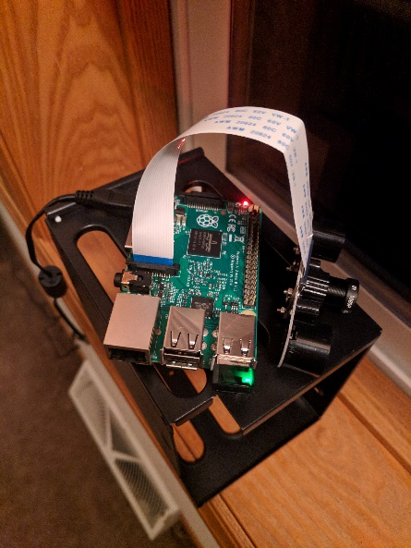
IoT Home Monitoring System
By Pengxue Her

Slide 2
Problem to solve
Home monitoring can be expensive to buy made to market solutions (upfront as much as $549 and monthly cost)
DIY projects can be limited in only viewing live video when on home network
Home Security Market expected to be $47 billion revenue by 2020 (Strong demand)
Desired solution: Relatively cheap DIY setup that allows over the web video streaming, with protection, while allowing for future work (i.e. door sensors, buzzers, etc)

Slide 3
Scope
View live video feed when away from Home network
Be notified when movement has occurred even when away from Home network
Set up infrastructure in a way to scale with more devices with relative ease

Slide 4
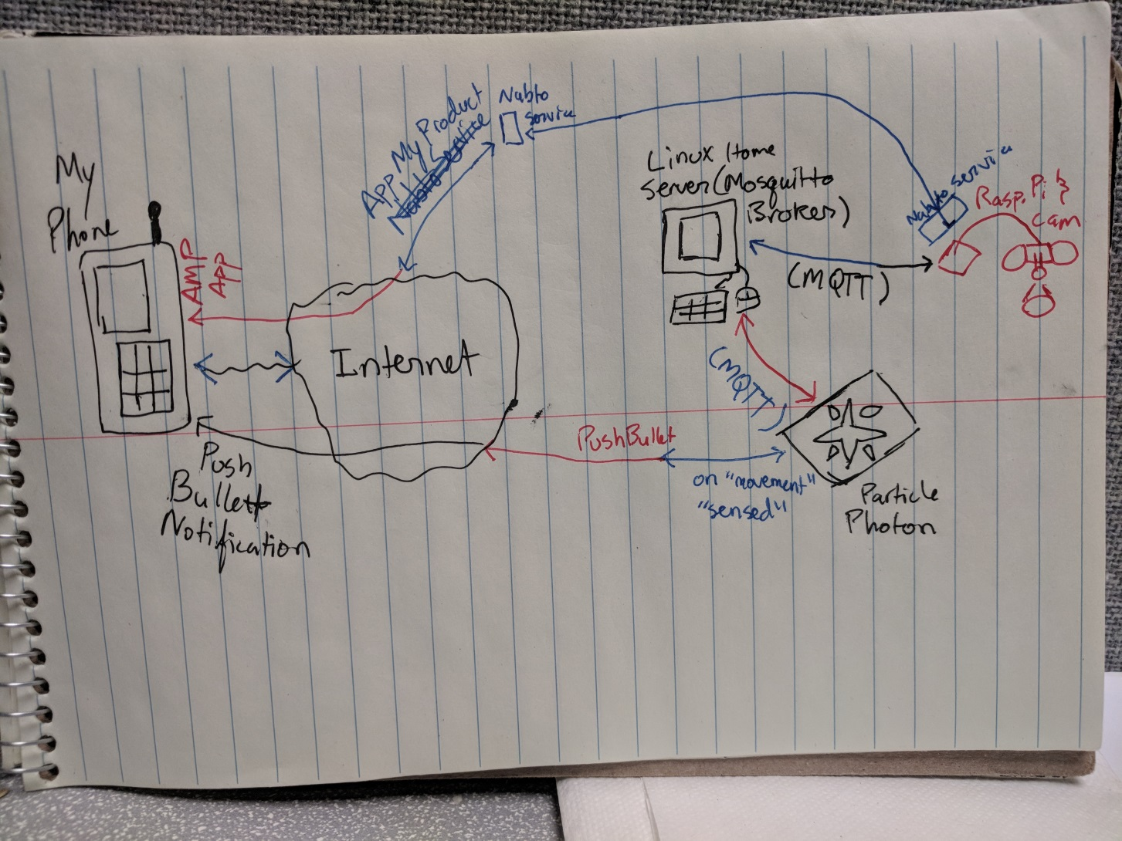
Diagram(Hand-Drawn)

Slide 5
Intended Solution
Raspberry Pi 2 with Pi Camera Module with App My Product (AMP) for secure video streaming connection
Home Linux Server running with Mosquitto MQTT broker
Particle Photon with MQTT capabilities and webhooks
Pushbullet for push notification to phone/devices

Slide 6



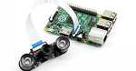
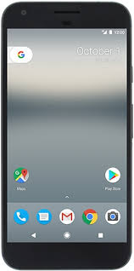


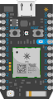
Diagram
Nabto tunnel service
Nabto tunnel service
MQTT
Push Notification
MQTT
Webhook

Slide 7
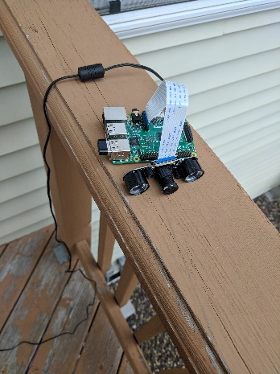
Raspberry Pi 2 with Camera Module & AMP
Raspian distro on Rasp. Pi.
Open source “motion” software package installed to work camera and sense motion
AMP is software service company that provides infrastructure for IoT products to help develop high quality apps
Uses nabto (P2P based platform) tunneling service on Raspian OS and phone app to allow over the web streaming
Free 1- year use, 0 – 99 devices

Slide 8
AMP (continued)
Have to be on same network and pair with the device first, (First owner to claim device can disable device from pairing with other devices)
Great fast way to get my project started

Slide 9
Mosquitto MQTT Broker
Open source MQTT broker light weight and implementable on several systems (raspian in my case)
Can do SSL certificates (In my case I did not implement it)
Lightweight messaging for devices

Slide 10
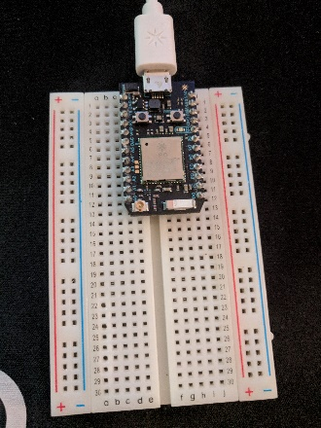
Particle Photon & Pushbullet
Subscribed to topic on Mosquitto MQTT Broker
Once specific message is received, activates webhook to Pushbullet
Pushbullet is an app that connects all your devices
Can sync messages, sync files, links from phone to laptop etc
Pushbullet sends push notification to my phone
Can send notifications to several devices such as web browsers, computers, etc.

Slide 11
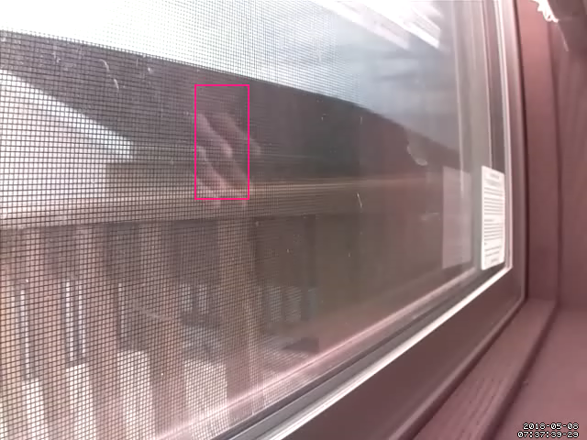
Video

Slide 12
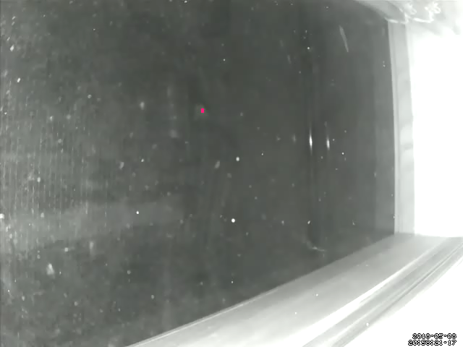
Video (Continued)

Slide 13
Cost
Needed to buy
Raspberry Pi 2 ($43.44)
Raspberry Pi Camera Module ($22.75)
USB WiFi Dongle ($8.99)
MicroSD 32 GB ($12.99)
Particle Photon ($19.00)
Total - $107.17
Already Had (potential cost)
Laptop ($150-$900)
Smartphone ($200-$700)
Possibilities..
Endless

Slide 14
SWOT
Strengths
Scalable to add any devices or sensors as a user would please
Less costly than market ready products
Flexible and user has total control of systems and hardware
Easily deployable and setup and configuration has good documentation (open source)
Weaknesses
No central GUI/software to control all components (a lot of configuration on multiple machines and devices)
Continual development takes a lot of time

Slide 15
SWOT (Continued)
Opportunities
Add main app/software that controls all components
Leverage more open source packages such as MQTT.Cool to open up Mosquitto broker to the internet securely
Add any device/sensor we can dream of and allow it to talk to MQTT broker
Threats
Security is not the securest (SSL for mosquitto, but only accessible In home network. Same for video streaming)
Leveraging other services that may charge in the future (AMP, Pushbullet, etc.)

Slide 16
Demo

Slide 17
References
http://www.robotpark.com/Raspberry-Pi-Night-Vision-Camera-Module-for-Model-Aplus-B-Bplus-2
https://www.iconfinder.com/icons/22919/laptop_icon
https://docs.particle.io/datasheets/photon-(wifi)/photon-datasheet/
https://www.inc.com/dan-scalco/why-home-security-systems-are-on-track-to-be-a-multi-billion-dollar-market.html
https://www.pcmag.com/article2/0,2817,2498510,00.asp

